Slide 1




Capstone Design Project
Weekly Progress
Perfect StudyMate
Team k
Juyong Rhee | Yewon Chun | Jihee Hwang | Jorge Alcorta

Slide 2
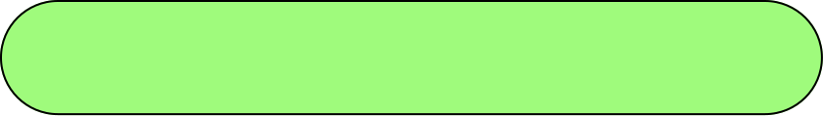

Milestone
 | Week5 | Week6 | Week7 | Week8 | Week9 | Week10 | Week11 | Week12 | Week13 | Week14 | Week15
Langchain & RAG Study
AI Structure Design
AI Architecture Development
Database Design
API Specification
API Integration
API Implementation
UI/UX Design
FrontEnd Implementation
Integration Testing
This week, we focused on API integration and model performance evaluation.

Slide 3








Role Division
Juyong Rhee
Yewon Chun
- Team Leader
- BackEnd Development
AI Model Development
Documentation
Jihee Hwang
Jorge Alcorta
UI/UX Designmer
FrontEnd Development
AI Model Development
Presentation

Slide 4
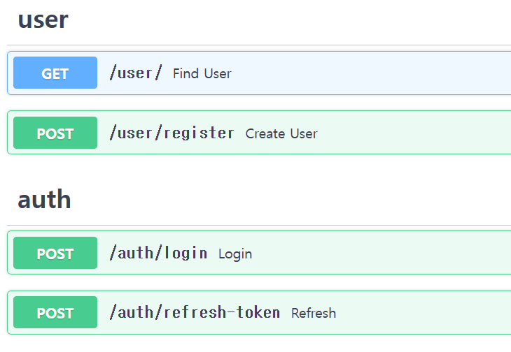

API Integration
Following last week, FE & BE Backend Integration was implemented.
The implementation of functions
related to user registration and authentication
has been completed.

Slide 5
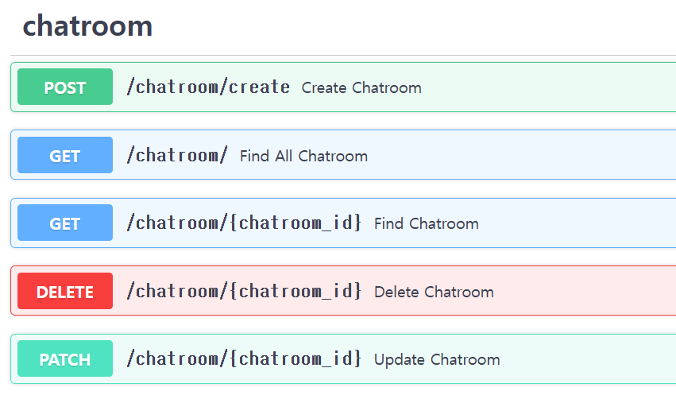

API Integration
Following last week, FE & BE Backend Integration was implemented.
The implementation of functions
related to chatrooms,
such as creating and deleting chatrooms
has been completed.

Slide 6
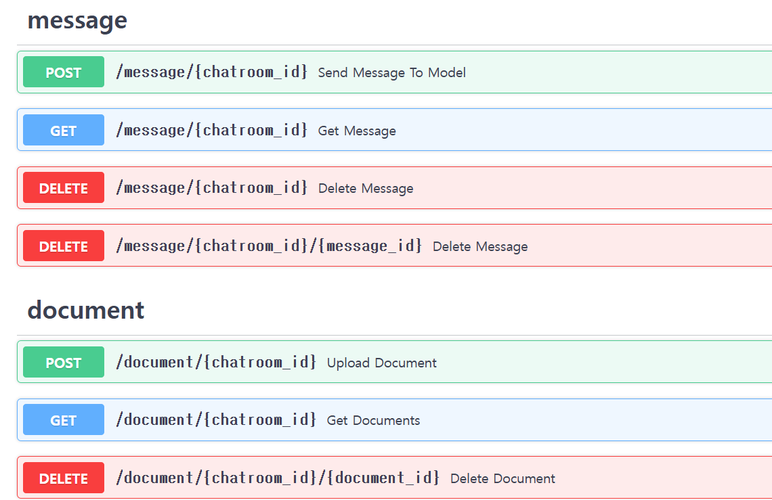
API Integration
Following last week, FE & BE Backend Integration was implemented.
Further API Integration is expected to be completed in the following week.

Slide 7
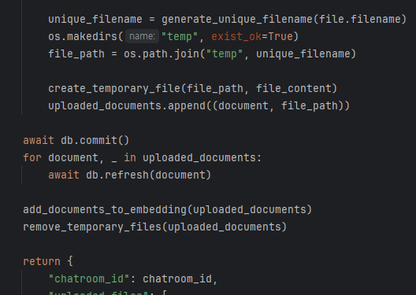
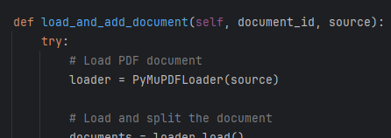
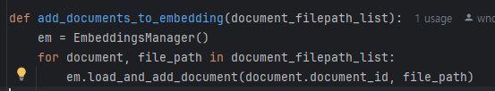
RAG Integration
AI code[EmbeddingsManager]: Using PyMuPDFLoader to load PDF file, then split and vectorize
Backend code[/upload_document]: Get file from frontend and call EmbeddingsManager class for embedding

Slide 8
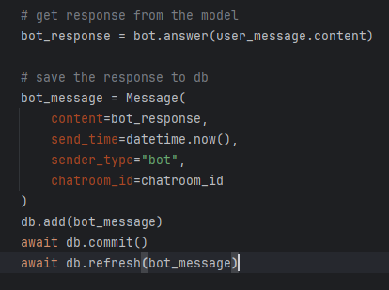
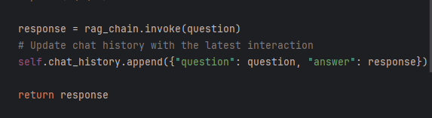
RAG Integration
AI code[Chatbot]: return response
Backend code[/send_message]: Call Chatbot class to get answer of user question

Slide 9
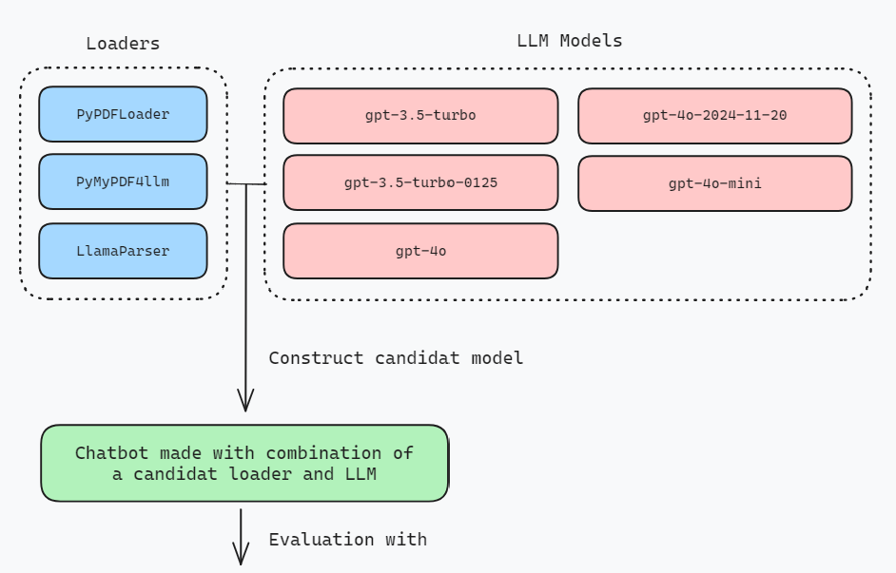

Performance Evaluation
As part of the model performance improvement, a process of comparing the performance of several loader and lm combinations was constructed.
Loaders
LLMs
PyPDFLoader
PyMyPDF4llm
LlamaParser
gpt-3.5-turbo
gpt-3.5-turbo-0125
gpt-4o
gpt-4o-mini
gpt-4o-2024-11-20
1
3 x 5 = 15 candidats of combinations

Slide 10
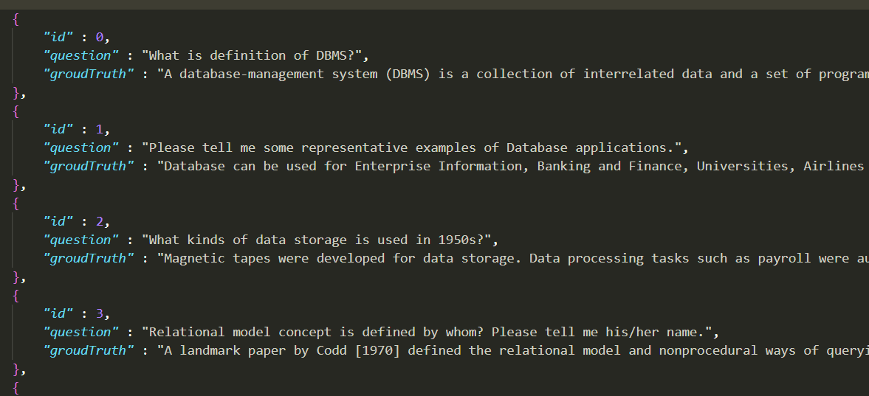
Performance Evaluation
2
Each model candidate is evaluated by n sample documents.
And each document consists of 5 to 10 question-ground truth pairs.
This is example of question-ground truth pairs.
It is data generated by humans based on the contents of the pdf.

Slide 11
Performance Evaluation
2
Each model candidate is evaluated by n sample documents.
And each document consists of 5 to 10 question-ground truth pairs.
This week, we compared using human made dataset.
But next week, we plan to use synthetic QA dataset using QA testset generator provided by RAGAS.
This is example of question-ground truth pairs.
It is data generated by humans based on the contents of the pdf.

Slide 12

Performance Evaluation
Why Synthetic Dataset?
Human generation of hundreds of QA samples from a document
can be time-consuming and labor-intensive.
Man-made questions are difficult to reach the level of complexity required for a thorough evaluation, which can ultimately affect the quality of the evaluation.
It can generate a level of questions that are challenging to generate at the human level !!

Slide 13
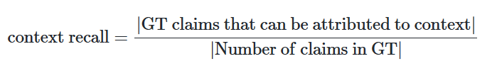
Performance Evaluation
3
Finally, five metrics can be evaluated from one QA pair.
Context Recall
It measures how much the searched context matches the answer generated by chatbot. That is, it is analyzed whether each argument in the round truth answer
can be attributed to the searched context.

Slide 14
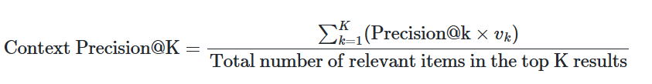
Performance Evaluation
3
Finally, five metrics can be evaluated from one QA pair.
Context Precision
A metrics that evaluates whether the ground-truth related items
in the context are ranked high, that is,
whether the retriever has properly embedded and extracted values.

Slide 15
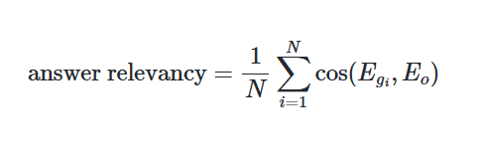
Performance Evaluation
3
Finally, five metrics can be evaluated from one QA pair.
Answer Relevancy
Answer Revancy is a metric that evaluates
how appropriate the generated answer is for a given prompt

Slide 16
Performance Evaluation
4
Finally, five metrics can be evaluated from one QA pair.
Faithfulness
Faithfullness is a metrics that measures
the factual consistency of generated answers against a retrieved context.
In other words, it determines the fidelity between the context and the actual response.

Slide 17
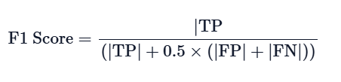
Performance Evaluation
5
Finally, five metrics can be evaluated from one QA pair.
answer_correctness
Answer crrectness involves gauging the accuracy of the generated answer when compared to the ground truth. A higher score indicates a closer alignment between the generated answer and the ground truth, signifying better correctness.

Slide 18
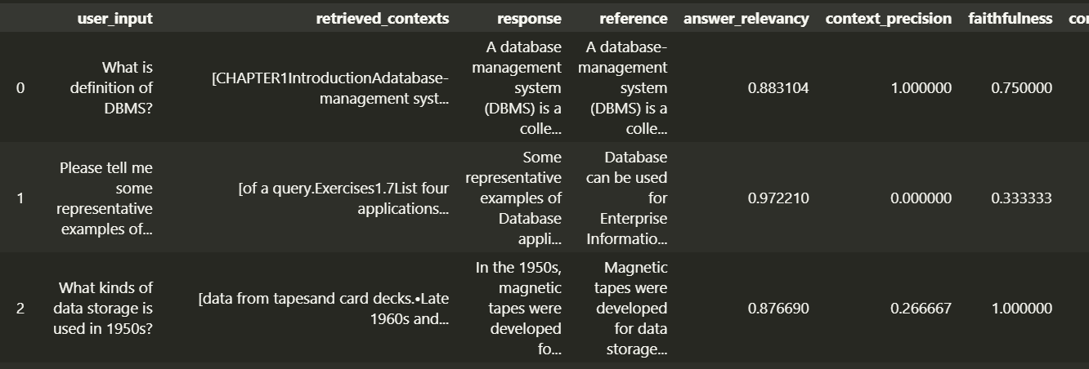
Performance Evaluation
Totally about 30 QA pairs evaluates 15 candidats of models.
Each model generates the answer and metrics.

Slide 19
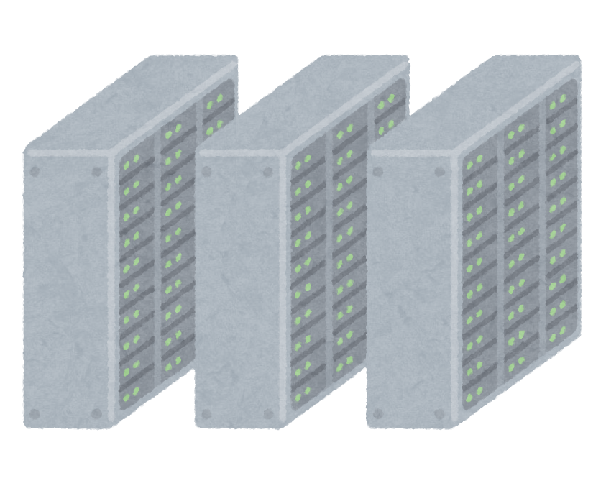

Performance Evaluation
Answer Relevancy, and answer correctness will be mainly used in evaluation.
Chroma DB
ChatBot
Embed
Retrieve
Answer Relevancy
Answer Correctness

Slide 20
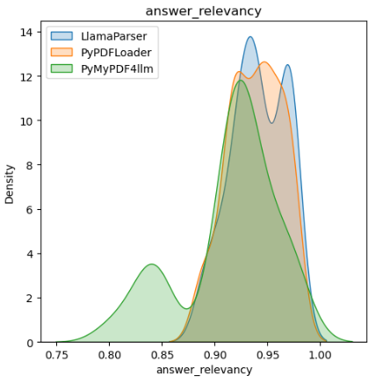
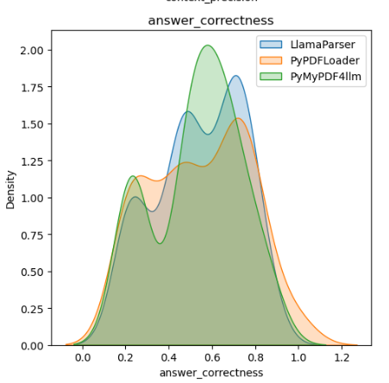
Performance Evaluation
Answer Relevancy & Correctness | loaders comparison
Answer Relevancy
Answer Correctness

Slide 21
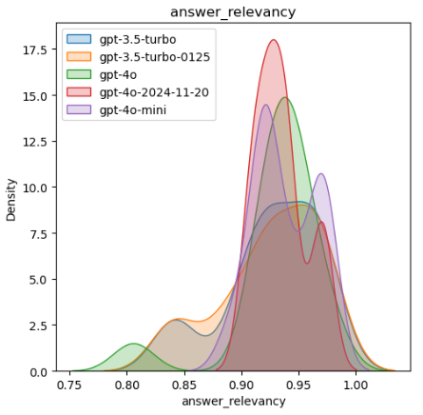
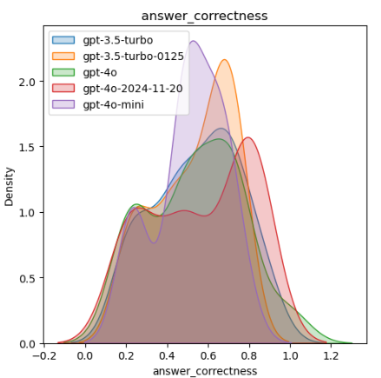
Performance Evaluation
Answer Relevancy & Correctness | llm comparison
Answer Relevancy
Answer Correctness

Slide 22
Performance Evaluation
Next Week …
More accurate evaluation composition using synthetic data
Composition of evaluations using more diverse domain pdf sources
Selection and evaluation of final models using model metrics statistics
rather than simple distribution visualization

